Slide 1

IC Biasing – Current Sources, Current Mirrors, and Current-Steering Circuits
Biasing in integrated-circuit design is based on the use of constant-current sources.
On an IC chip with a number of amplifier stages, a constant dc current (reference current) is generated at one location and is then replicated at various other locations for biasing.
This is known as current steering.
This approach has the advantage that the effort expended on generating a predictable and stable reference current need not be repeated.

Slide 2
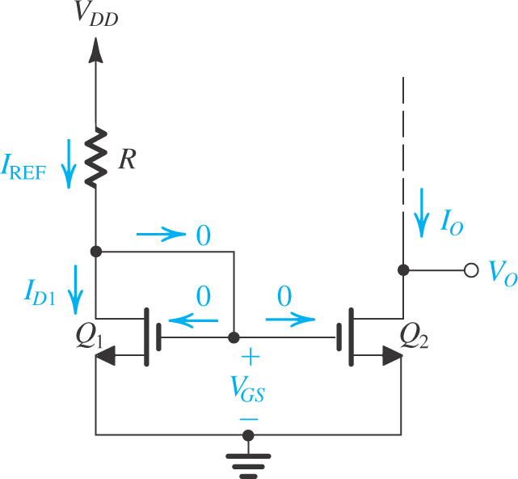
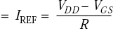
The Basic MOSFET Current Source
Widely used for ICs with good device matching
Figure shows the circuit of a simple MOS constant-current source.
The heart of the circuit is transistor Q₁, the drain of which is shorted to the gate, thereby forcing it to operate in saturation mode.
The drain current of Q₁ is supplied by V_{DD} through resistor R which in most cases is located outside of the IC chip.
If one considers transistor Q₂, it is realized that it has V_{GS} identical to Q₁
Figure: Circuit for a basic MOSFET constant-current source. For proper operation, the output terminal, that is, the drain of Q₂, must be connected to a circuit that ensures that Q₂ operates in saturation.
Consider transistor Q₂

Slide 3
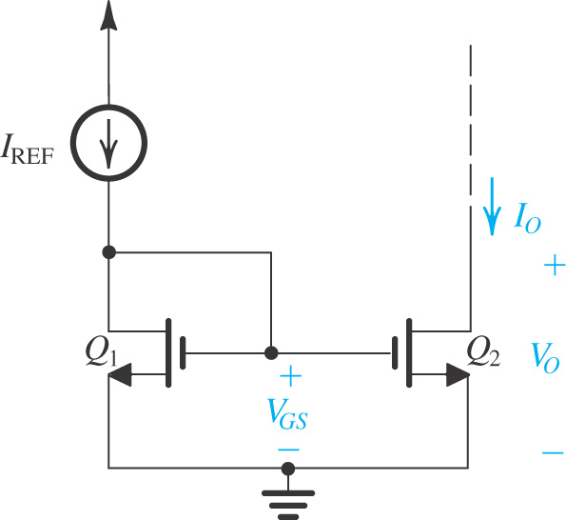
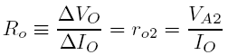
The Basic MOSFET Current Source
The combination of Q₁ and Q₂ is referred to as a current mirror.
Figure depicts the current-mirror circuit with the input reference current shown as being supplied by a current source for both simplicity and generality.
The current gain or current transfer ratio of the mirror is given by (*).
The effect of V_{o} on I_{o} is defined in equations :
(*)
Figure: Basic MOSFET current mirror.
To ensure that Q₂ is saturated V_{O} ≥ V_{GS} – V_{tn}
The output resistance:
V_{A2} is the Early voltage of Q₂
We can express the current I_{o}

Slide 4
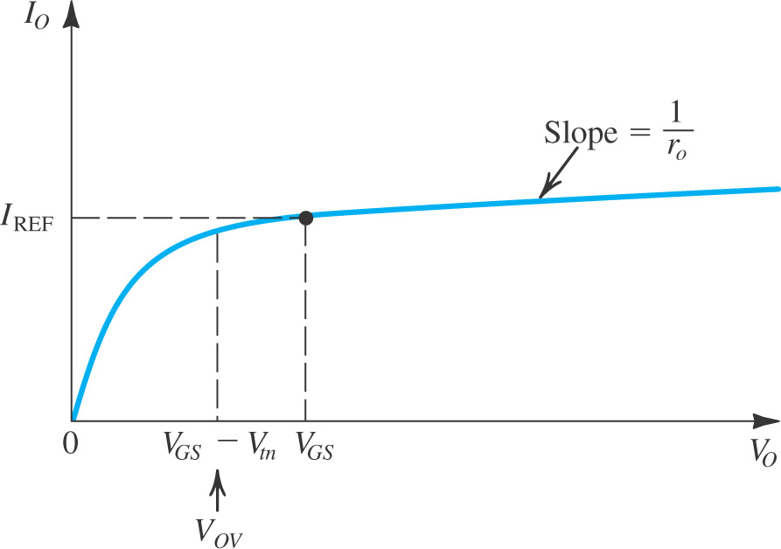
The Basic MOSFET Current Source
Figure: Output characteristic of the current source and the current mirror for the case of Q₂ matched to Q₁.

Slide 5
Example
Given V_{DD} = 3V and using I_{REF}= 100μA, design the circuit of Fig. to obtain an output current whose nominal value is 100 μA. Find R if Q₁ and Q₂ are matched and have channel lengths of 1 μm, channel widths of 10 μm, V_{t} = 0.7 V and k’_{n} = 200 μA/V². What is the lowest possible value of V_{o}? Assuming that for this process technology, the Early voltage V’_{A} = 20 V/μm, find the output resistance of the current source. Also, find the change in output current resulting from a +1-V change in V_{o}.

Slide 6
Example - Solution
For the transistors used, L = 1 μm.
The output current will be 100 μA at V_{o} = V_{GS} = 1V. If V_{o} changes by +1 V, the corresponding change in I_{o} will be

Slide 7
MOS Current-Steering Circuits
Once a constant current has been generated, it can be replicated to provide dc bias or load current for the various stages of the amplifier in an IC.
Current mirrors can be used to achieve this goal.
Current sink: pulls a dc current from a circuit
Current source: pushes a dc current into a circuit
All transistors should be operated in saturation
Current mismatch exists for a finite VA (channel-length modulation)

Slide 8
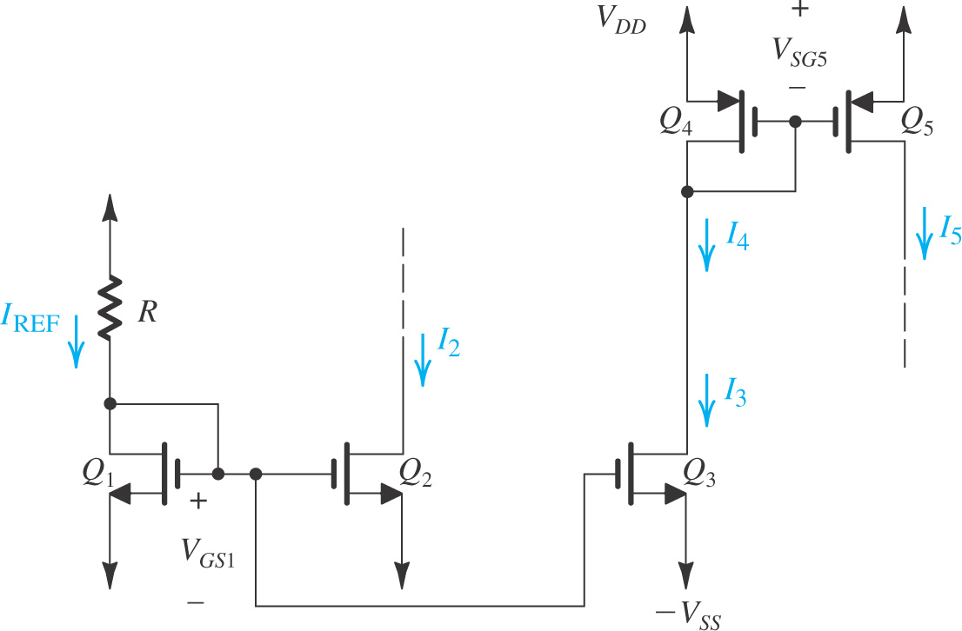
MOS Current-Steering Circuits
Transistors Q₁, Q₂, and Q₃ form a two-output current mirror.
To ensure operation in the saturation region V_{D2}, V_{D3} ≥ –V_{SS} +V_{GS1} −V_{tn}
Current I₃ is fed to the input side of a current mirror formed by PMOS transistors Q₄ and Q₅.
where I₄ = I₃. To keep Q₅ in saturation
V_{D5} ≤ V_{DD} − |V_{OV5}|
Figure: A current-steering circuit.

Slide 9
Important note is that in the circuit, while Q₂ pulls its current I₂ from a circuit (not shown in Fig.), Q₅ pushes its current I₅ into a circuit (not shown in Fig.). Thus Q₅ is appropriately called a current source, whereas Q₂ should more properly be called a current sink. In an IC, both current sources and current sinks are usually needed.
Figure: A current-steering circuit.

Slide 10
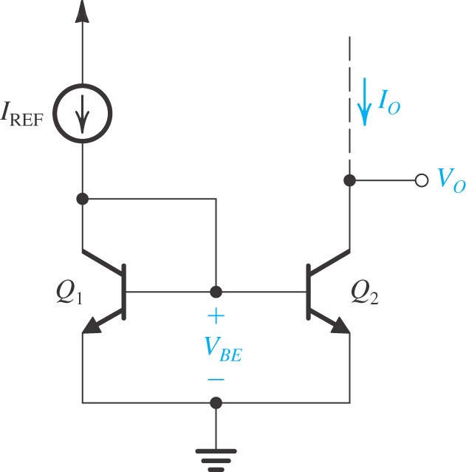
BJT Circuits
The basic BJT current mirror is shown in Fig.
It works in a fashion very similar to the MOS mirror. However, with two important differences:
The non-zero bias current causes an error in current mirroring (magnitude of current conducted).
The current transfer ratio is determined by the relative areas of the emitter-based junctions of Q₁ and Q₂.
The textbook provides a more detailed description of the BJT-based current mirror – including equations which correspond to those provided for MOS-based mirror.
Figure: The basic BJT current mirror.

Slide 11
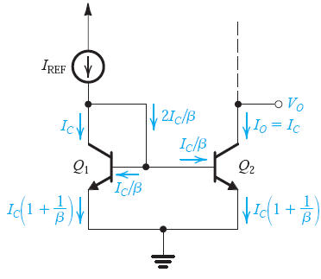
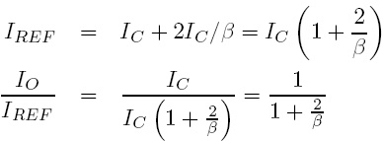
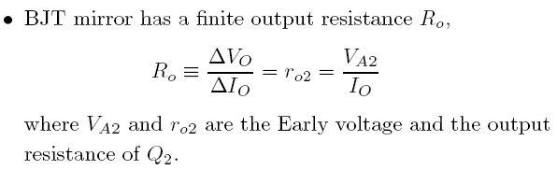
BJT Circuits
Figure: Analysis of the current mirror
taking into account the finite β of the BJTs.

Slide 12
BJT Circuits
Figure: A simple BJT current source.

Slide 13
BJT Circuits
Current Steering
Q₃ will supply a constant current I equal to I_{REF} .
Two transistors, Q₅ and Q₆ are connected in parallel, and the combination forms a mirror with Q₁. Thus I₃ = 2I_{REF} .
Constant current I₂ equals to I_{REF} .
Finally, to generate a current three times I_{REF} , three transistors, Q₇,Q₈ and Q₉, each of which is matched to Q₂, are connected in parallel.
Figure: Generation of a number of constant currents of various magnitudes.

Slide 14
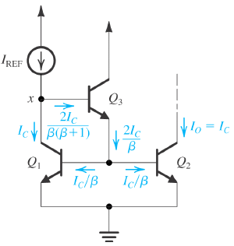
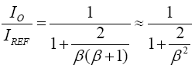
Current-Mirror Circuits with Improved Performance
A Bipolar Mirror with Base-Current Compensation
Base-current compensation by an additional transistor Q₃
The current transfer ratio is much less dependent on β
Output resistance R_{o} ≈ r_{o2}

Slide 15
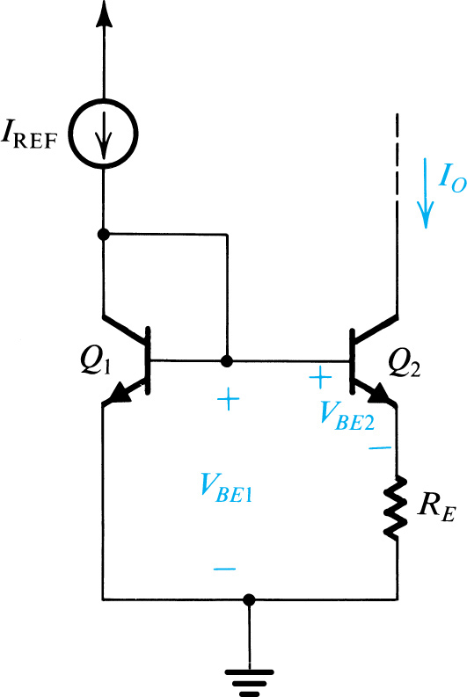
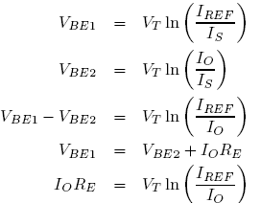
The Wildar Current Source
A resistor R_{E} is included in the emitter lead of Q₂.
Allows the generation of a small constant current using relatively small resistors
Advantageous in considerable savings in chip area for integrated circuits
Neglecting base currents we can write as:
Figure: The Widlar current source.
Output resistance is

Slide 16
Example
Fig. shows two circuits for generating a constant current I_{O} = 10μA which operate from a 10-V supply. Determine the values of the required resistors assuming that V_{BE} is 0.7V at a current of 1 mA and neglecting the effect of finite β.

Slide 17
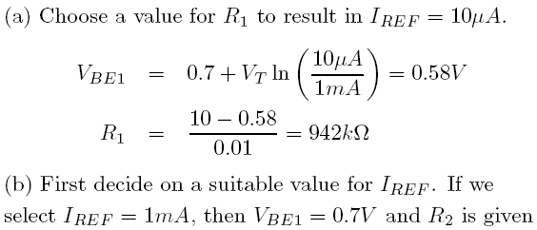
Example - Solution

Slide 18
Summary
Integrated-circuit fabrication technology offers the circuit designer many exciting opportunities, the most important of which is the large number of inexpensive small-area MOS transistors. An overriding concern for IC designers, however, is the minimization of chip area or “silicon real estate.” As a result, large-valued resistors and capacitors are virtually absent.
The basic gain cell of IC amplifier is the CS (CE) amplifier with a current-source load. For an ideal current-source load (i.e. one with infinite output resistance), the transistor operates in an open-circuit fashion and thus provides the maximum gain possible: A_{vo} = -g_{m}r_{o} = -A₀.

Slide 19
Summary
The intrinsic gain A₀ is given by A₀ = V_{A} / V_{T} for a BJT and A₀ = V_{A}/(V_{OV}/2) for a MOSFET. For a BJT, A₀ is constant independent of bias current and device dimensions. For a MOSFET, A₀ is inversely proportional to I_{D}^{1/2}. See equation 7.15.
Simple current-source loads reduce the gain realized in the basic gain cell because of their finite resistance (usually comparable to the value of r_{o} of the amplifying transistor).
To raise the output resistance of the CS or CE transistor, we stack a CG or CB transistor on top. This is cascoding. The CG or CB transistor in the cascode passes the current g_{m1}v_{i} provided by the CS or CE transistor.

Slide 20
Summary
A MOS cascode amplifier operating with an ideal current source load achieves a gain of (g_{m}r_{o})² = A₀².
To realize the full advantage of cascoding, the load current-source must also be cascoded, in which case a gain as high as 1/2A₀² can be obtained.
Double cascoding is possible in the MOS case only. However, the large number of transistors in the stack between the power-supply rails results in the disadvantages of a severely limited output-signal swing. The folded-cascode configuration helps to resolve this issue.

Slide 21
Summary
A CS amplifier with a resistance Rs in its source lead has an output resistance R_{o} = (1+g_{m}R_{S})r_{o}. The corresponding formula for the BJT case is R_{o} = [1+g_{m}(R_{e}||r_{π})]r_{o}.
Biasing in integrated circuits utilizes current sources. As well, current sources are used as load devices. Typically an accurate and stable reference current is generated and then replicated to provide bias current for the various amplifier stages on the chip. The heart of the current-steering circuitry utilized to perform this function is the current mirror.

Slide 22

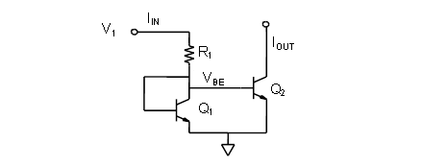
Quiz 2.6
a) A power supply V_{DD} = 3.3V, V_{GS} = 1.2V and I_{REF} = 120μA. Q1 and Q2 have k’_{n} = 200 μA/V², threshold voltages V_{t1} = V_{t2} = 0.8V.
Determine R.
Determine threshold voltage (W/L)₁.
If I_{o} = 100μA, find (W/L)₂.
b) A BJT current mirror depicted in the Figure has the power supply V₁ = 5V, V_{BE} = 0.7V corresponding to working current. Q1 and Q2 are matched and β = 100 .
Determine R₁ to obtain I_{IN} = 2mA.
Determine approximated value of I_{o}.
You submit your solution not later than March 20, 2020.
You can submit through Blackboard as informed by Mr. Huy on Blackboard announcement.

